Slide 1
SAP BTP Architect Training
Day 6
Anubhav Oberoy
www.AnubhavTrainings.com
Follow excellence with sheer passion

Slide 2


DISCLAIMER
The training content and delivery of this presentation is confidential, and cannot be recorded, or copied and distributed to any third party, without the written consent of Anubhav Trainings

Slide 3
Agenda – Day 6
01
CDS Views
02
Business Application Studio
03
Generic Service handlers & Test

Slide 4
Introduction to CDS Views
1. Usually we have all our data distributed across multiple tables, and if we need to get this data out, we need to write complex queries with joins. It becomes very complex to handle the maintenance of these large queries. Views will simplify the consumption and make it easy to maintenance.
2. We can perform operations like aggregation on the view.
3. Security
4. CDS views are also the contracts for data consumption
5. They include annotations which drive functionality.
6. View provide lose coupling to load data. Whereas when we use queries and joins, they are always tight coupling.
Exercise:
https://github.com/soyuztechnologies/SAP_BTP_Training_CLD200/blob/master/Day%203/01%20db/01db/CDSViews.cds
Purchase order
Purchase order items
Load what is needed

Slide 5
























Requirements
The name of the object must be case-sensitive, the view should decompose all associations, in a single view we should know the PO vendor and PO Item product data.

Slide 6
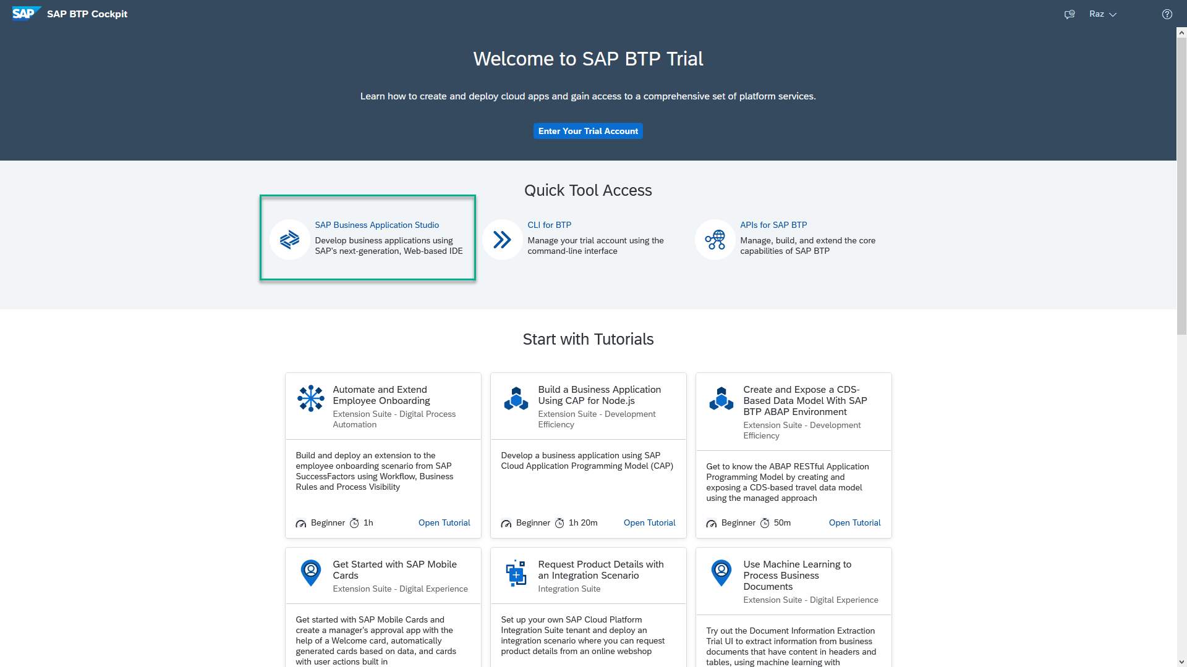
Business Application Studio
SAP Business Application Studio is a development environment available on SAP Business Technology Platform. Before you can start developing using SAP Business Application Studio, administrators must perform the required onboarding steps that are described in this tutorial.
In an Enterprise Account you can set up SAP Business Application Studio as a Free-Tier service by checking its free plan during its entitlement configuration.

Slide 7
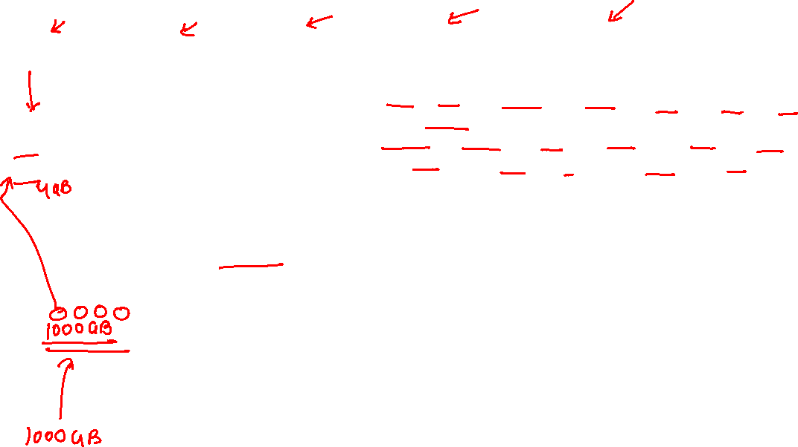
Dev Space in BAS
We don’t want a single developer to consume all the available resources
We want a clear isolation of one developer with another
Pre-configured by sap for specific development
Solution - Virtualize
Dev Space
Dev Space
Dev Space
SAP BAS – Business App Studio
SAP BTP – Platform as a Service
IaaS – Infrastructure as a Service

Slide 8

















Slide 9


Hands on: Move App to BAS

Slide 10
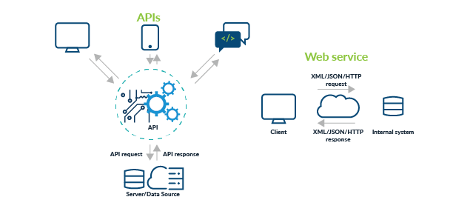
Testing Services in BAS
Exercise:
https://github.com/soyuztechnologies/SAP_BTP_Training_CLD200/blob/master/Day%203/02srv/tester.http

Slide 12

What We Did
Let’s Summarize

Slide 13

www.anubhavtrainings.com
Thank You
End of Day 3

Slide 14


We’re committed to empower you to be
#FutureReady
through powerful training solutions.
We build the workforce of the future.
250+
Corporate Clients
40,000+
Learners Trained
25000+
Learners Placed
FREE WEBINARS
Sign up for free webinars with industry experts every fortnight!
Enroll Now!
Contact us today!
https://anubhavtrainings.com

Slide 15
Agenda – Day 3
01
Understanding Aspects and associations
04
Generic Service handlers
02
05
Working with Service Layer
Introduction to Fiori Elements
04
06
Business Application Studio
Adding UI module

